Slide 1
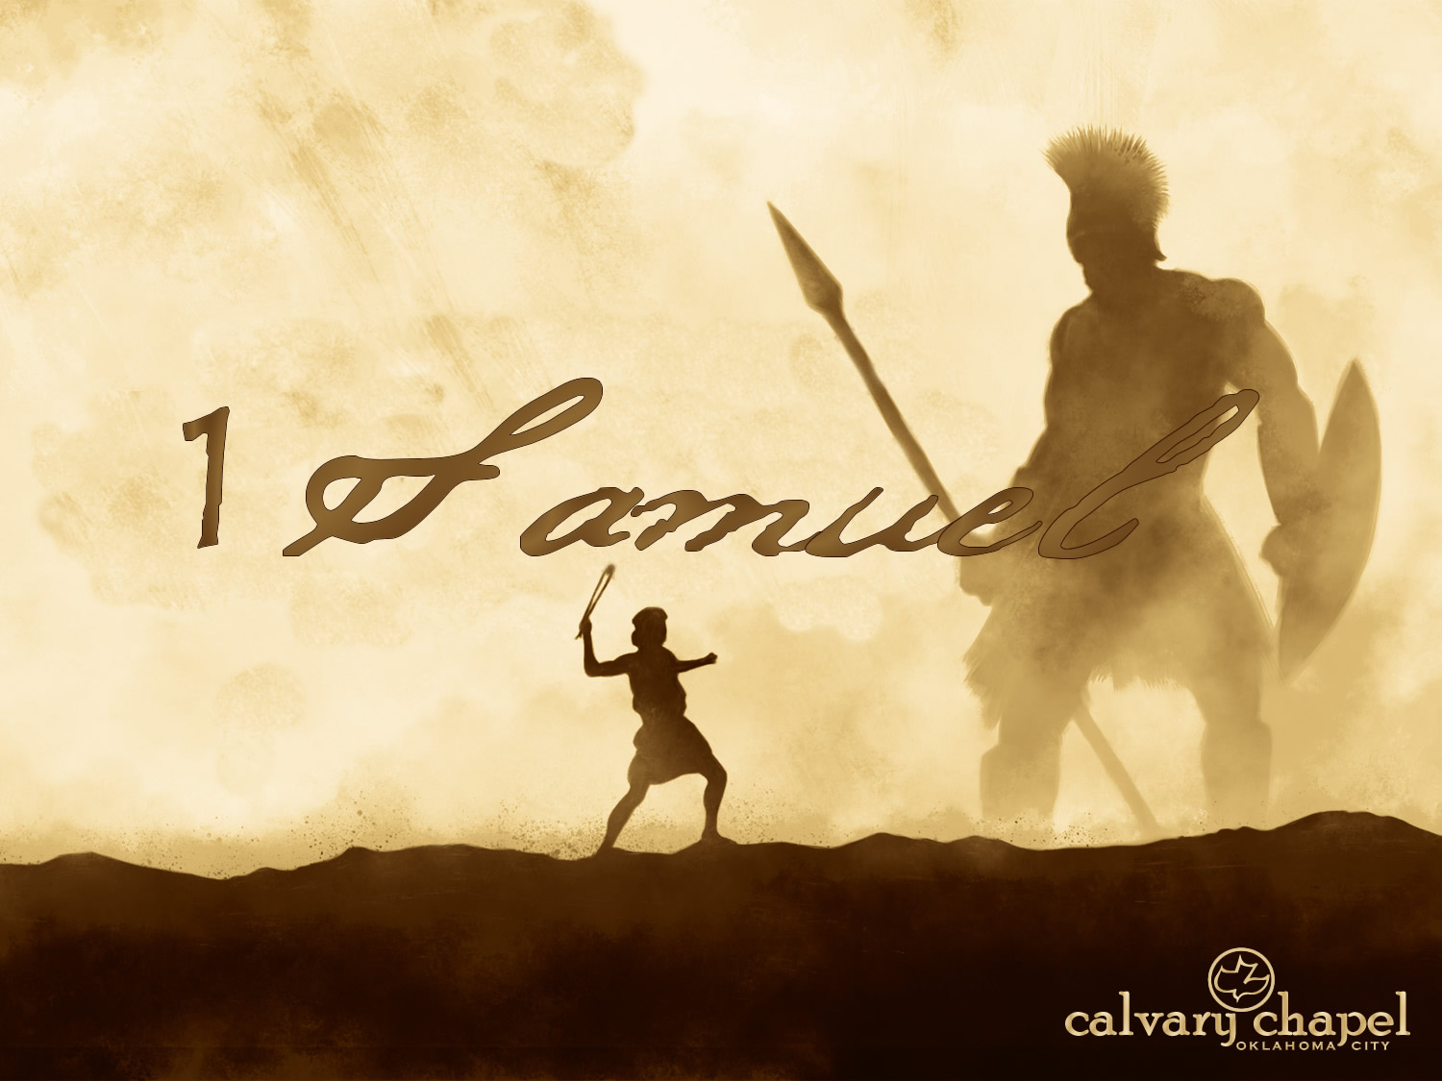

A CD of this message will be available (free of charge) immediately following today's message
This message will be available via podcast later this week at calvaryokc.com
03-05

Slide 2
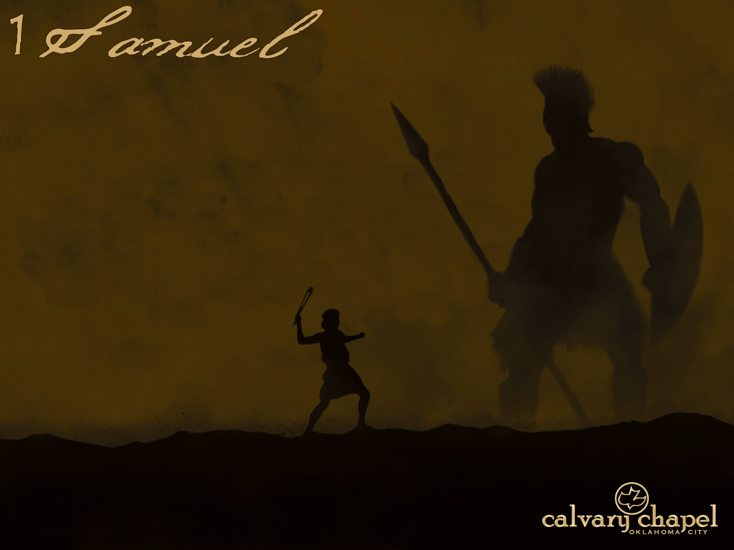
03-05
C. H. Spurgeon ~ “‘Speak, Lord!’ While the minister is speaking, Lord do thou speak. I have heard the minister’s voice, and sometimes it awakens me, but I am not saved, and I never shall be, Lord, if the minister speaks alone. Speak, Lord! My mother has talked with me; my earnest teacher has sought to lead me to the Saviour; but I know that the words of blessed men and women will fall to the ground if they come alone . . . Oh, let it be to-night a real work of grace in my soul! Let divine power come and operate upon me.”

Slide 3
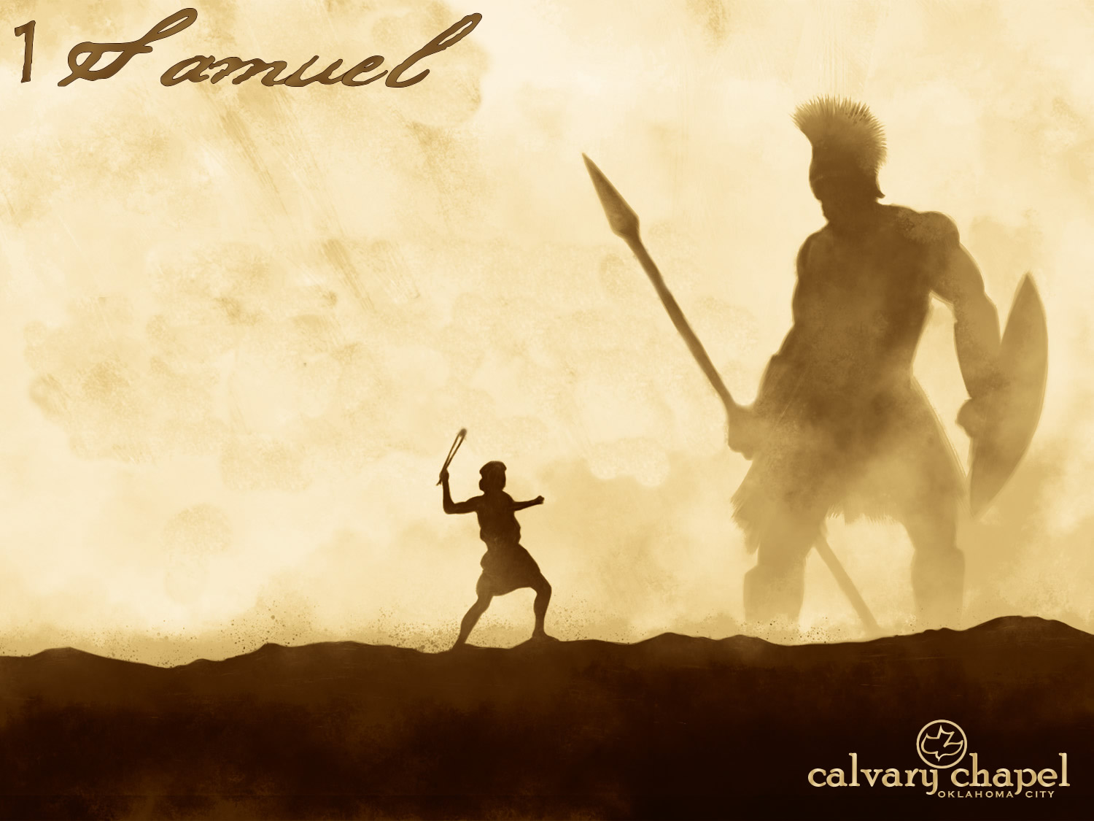
03-05

Slide 4
03-05
Ebenezer ~ Stone of Help (7:12)

Slide 5
03-05

Slide 6
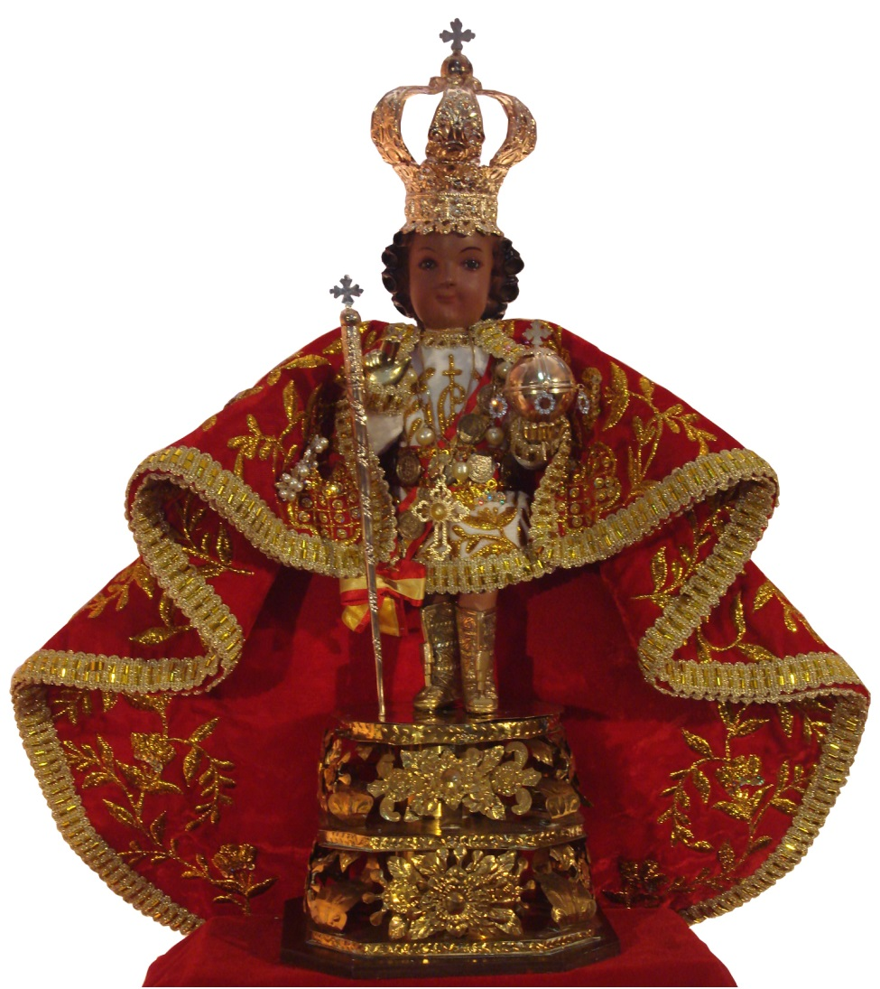
03-05
Santo Niño

Slide 7
03-05

Slide 8
03-05
Conduct yourselves like men ~ KJV, Quit yourselves like men

Slide 9
03-05

Slide 10
03-05
Ichabod ~ no glory - kabode

Slide 11
03-05

Slide 12
03-05
Dagon ~ dag - fish; dagah - to grow

Slide 13
03-05

Slide 14
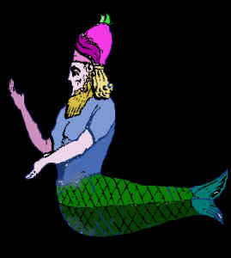
03-05
KJV ~ only the stump of Dagon was left to him.

Slide 15
03-05

Slide 16
03-05
Tumors ~ KJV emerods (hemorrhoids)

Slide 17
03-05

Slide 18
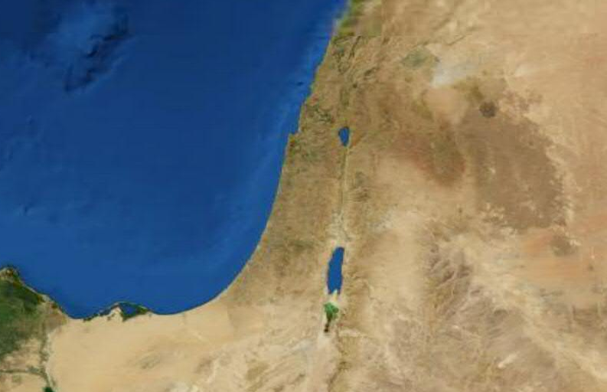
03-05
Ashdod
Gath

Slide 19
03-05

Slide 20
03-05
KJV ~ and they had emerods in their secret parts.

Slide 21
03-05

Slide 22
03-05
Ashdod
Ekron
Gath

Slide 23
03-05

